Slide 1

CHOP R 101: Intro to R for Clinical Data
Dashboard
Notes:
In this final session of today, we'll take a look at how you can apply the R skills you've learned today to build a simple dashboard.

Slide 2
The Data Analysis Pipeline
From R for Data Science (https://r4ds.had.co.nz/introduction.html)
Notes:
Communicating your results is a key step in data analysis. We’ve already looked at static reports that are created when you knit a Rmd file.
But an important way in which clinical information is presented is not in static reports that need to be built manually, but instead in interactive dashboards.

Slide 3
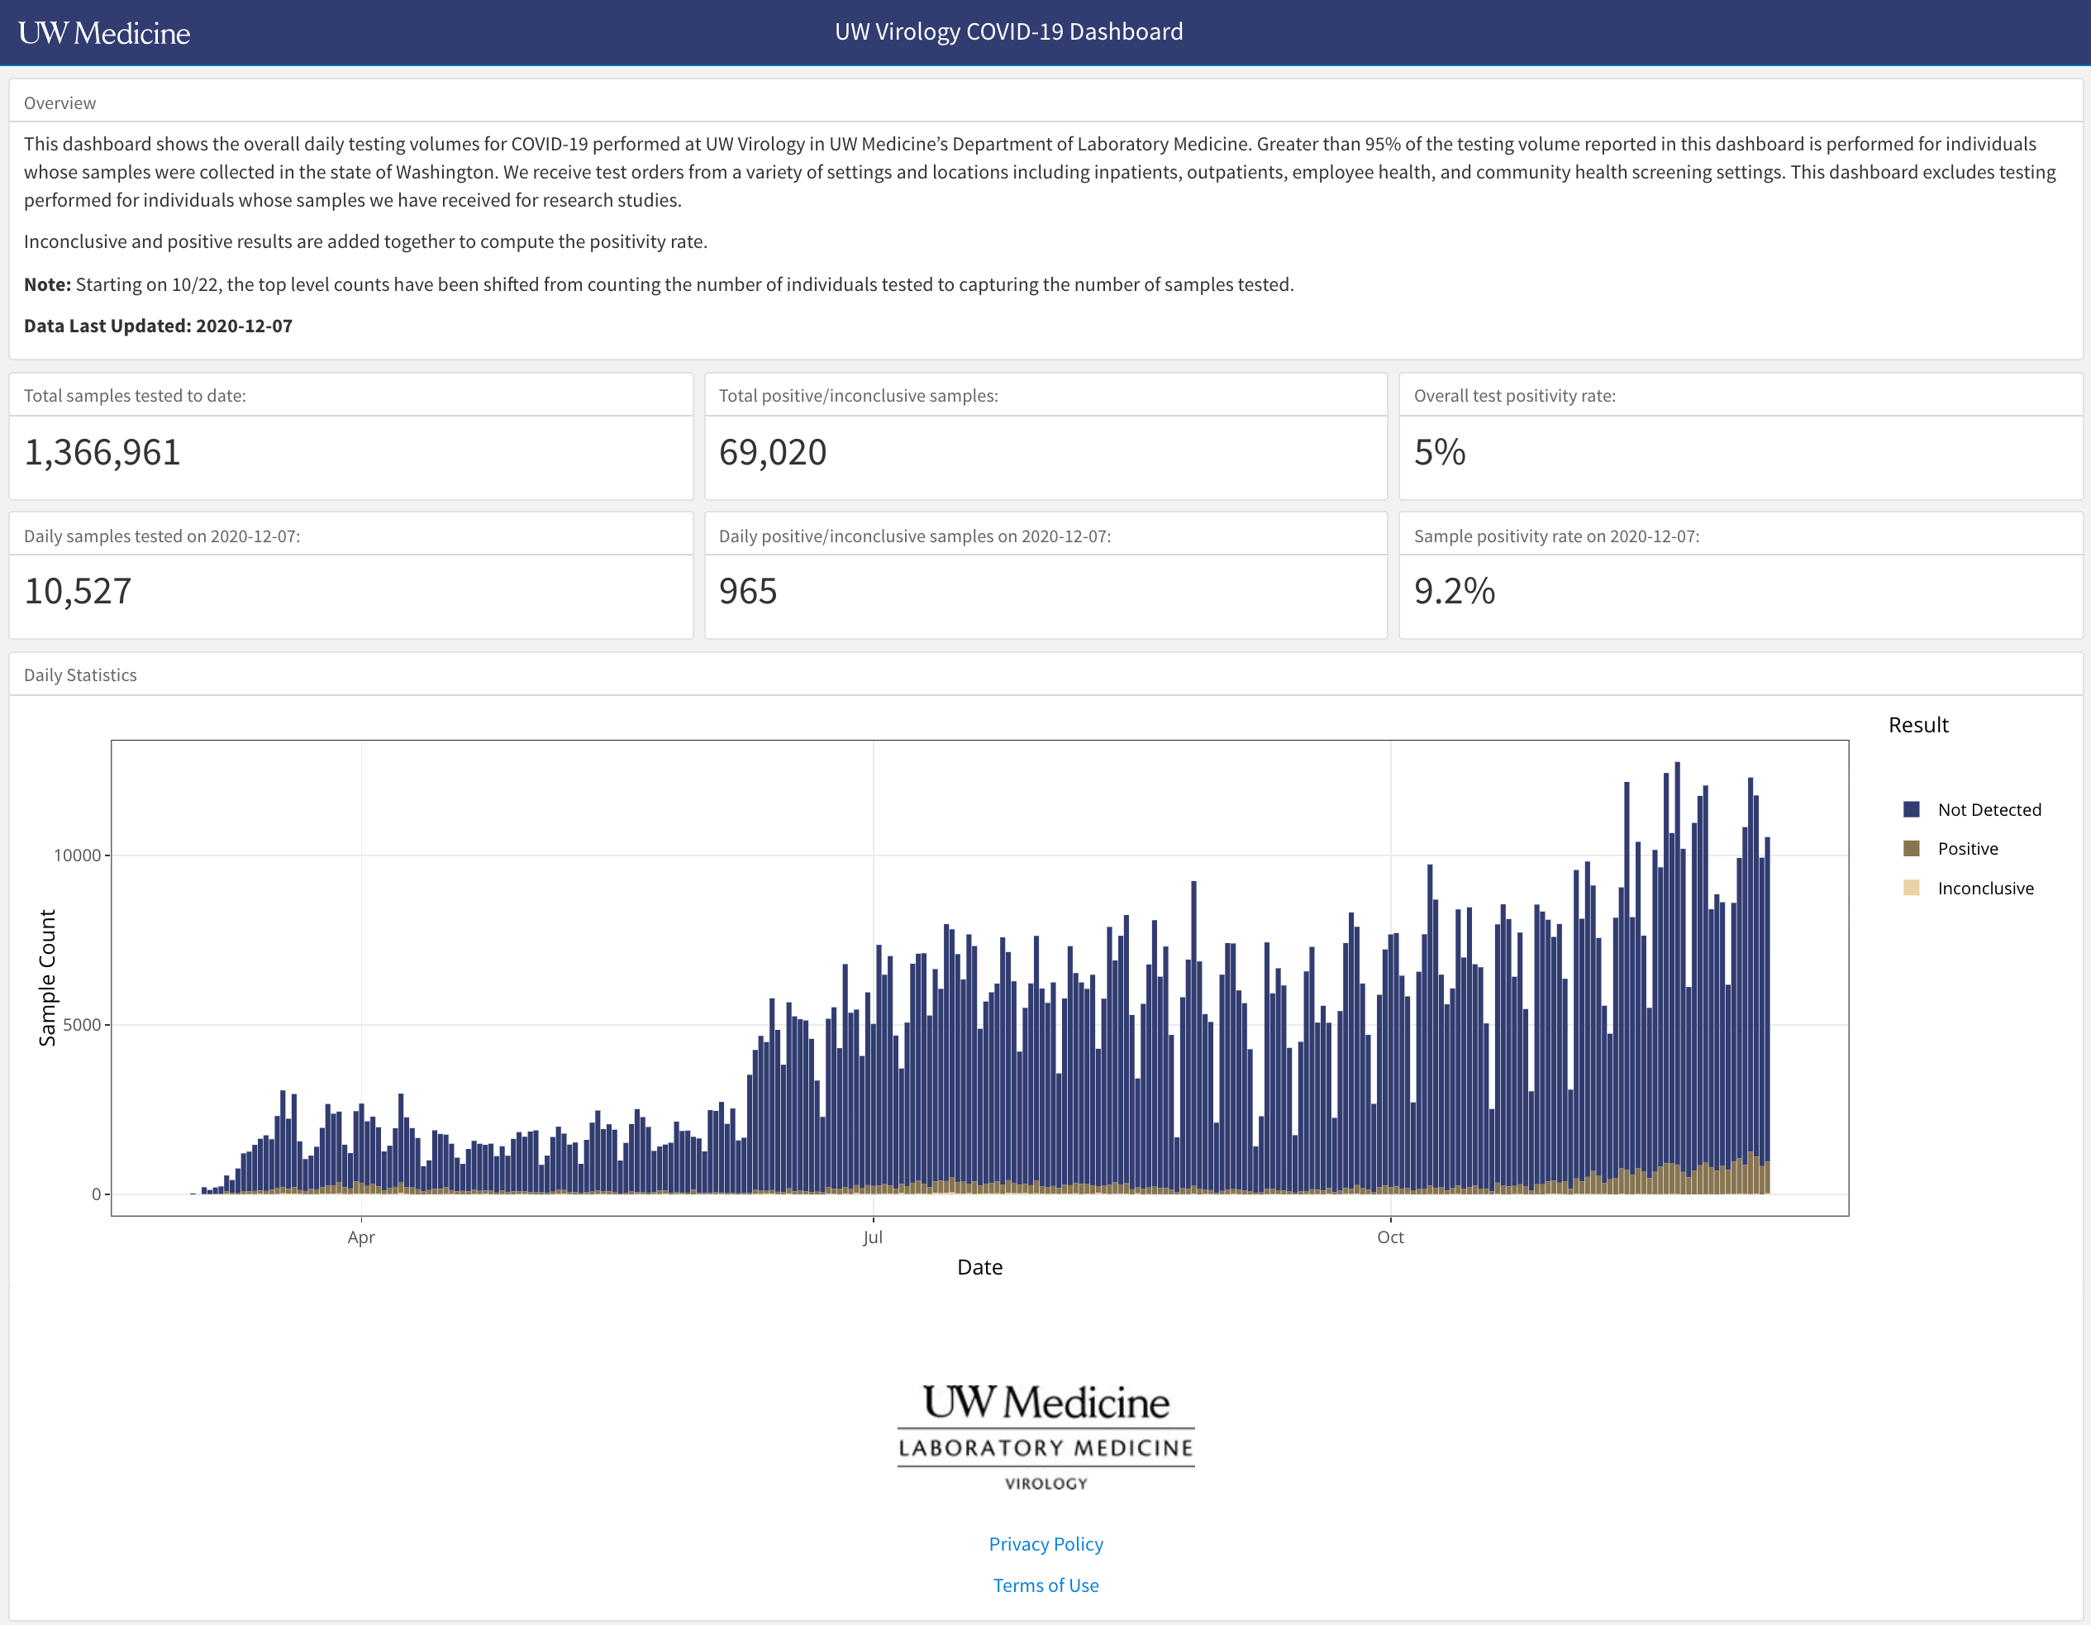
Dashboards visualize key data on demand
Notes:
Dashboards are a great way to communicate results because they display key data on demand.
For example, this is the public-facing COVID19 testing dashboard of the University of Washington Lab Medicine Virology lab. By pointing your browser to a specific web site, you can see at a glance some key performance indicators, such as total samples tested to date, which is an impressive 1.3 million as of yesterday; and other numbers such as test positivity rate, daily positives, etc.
In addition, there's a histogram of test volume over time, color coded by result. What I can’t show here because it’s a PowerPoint, is that the histogram is actually an interactive plot that lets me zoom in and get more detailed information by hovering over specific bars.

Slide 4
Turn an R Markdown document into an interactive dashboard
Notes:
This dashboard we just looked at was written in R Markdown – using a package called flexdashboard, which allows you to turn an R Markdown document into an interactive dashboard.

Slide 5
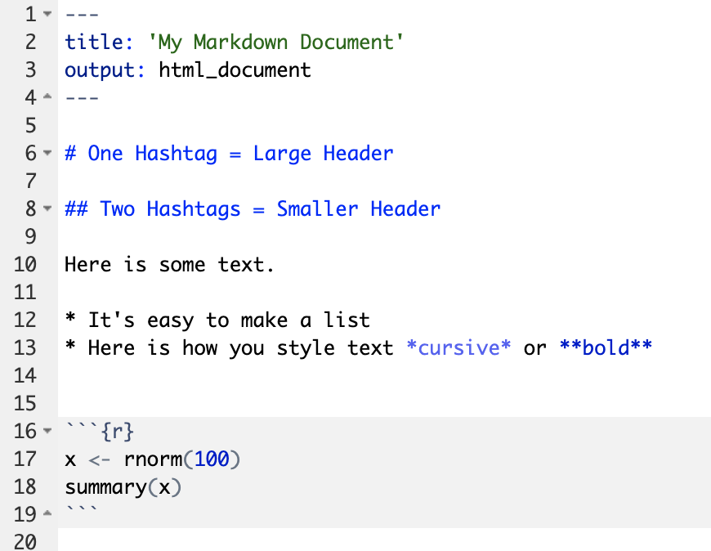
Recap: Anatomy of an R Markdown Document
Header
Header
Text (with marks)
Code chunk
Notes:
Recall that an R Markdown document has 3 different types of building blocks, the header, text, and code chunks.

Slide 6
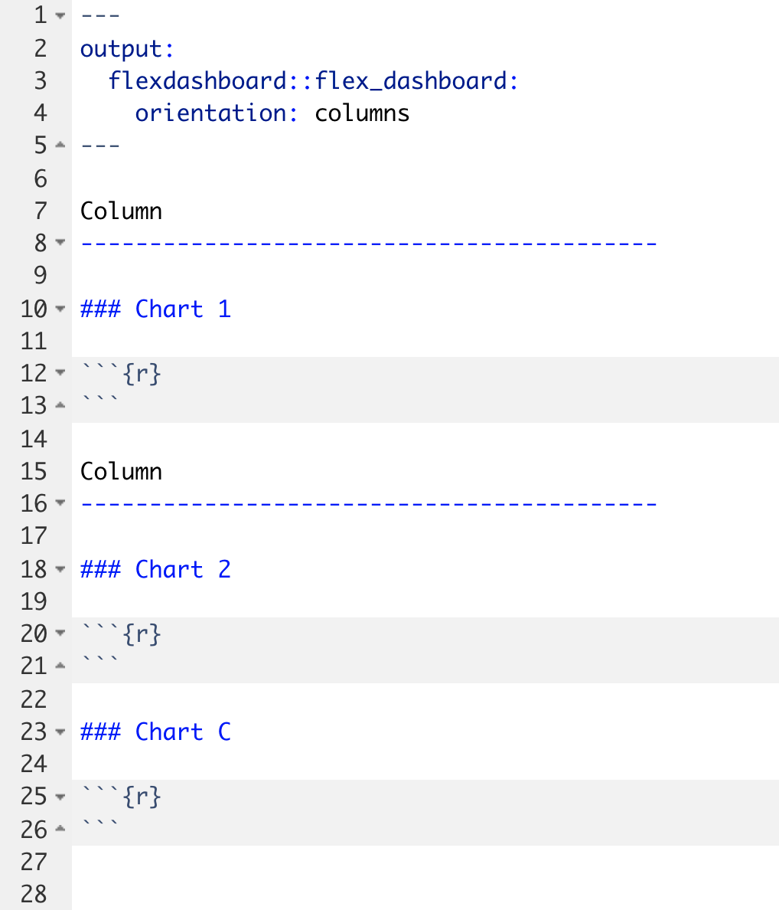
Notes:
A Flexdashboard document is an R Markdown document, so it has these elements as well.
For example, look at this flexdashboard document.
You have the header that starts and end with 3 dashes - what's new is that the output is no longer an html_document, it's a flexdashboard. Also note that there is another option specified: orientation: columns. This is how you tell flexdashboard that you want the content organized in columns, and that’s shown on the right.
All the content of the dashboard goes below the header.
To add a column, you write “Column” and a whole bunch of dashes (at least 5 I believe). It actually doesn’t matter whether you write “Column” here, but by convention this is what people do to remind themselves that you’re organizing your dashboard into columns.
This is actually a different way to write a level-2 heading in R Markdown, which would start with two hash tags.
To add a chart inside a column, add a level-3 header – by writing a line starting 3 hashtags – followed by the name of the chart.
In this case, we’re adding two columns. The first column has one chart in it, labeled “Chart 1”, and the second has two charts in it, labeled “Chart 2” and “Chart 3"
It’s not important that you remember exactly how to define columns or charts. Usually you will start with a template, add content to it, and tweak it until you get what you want.

Slide 7
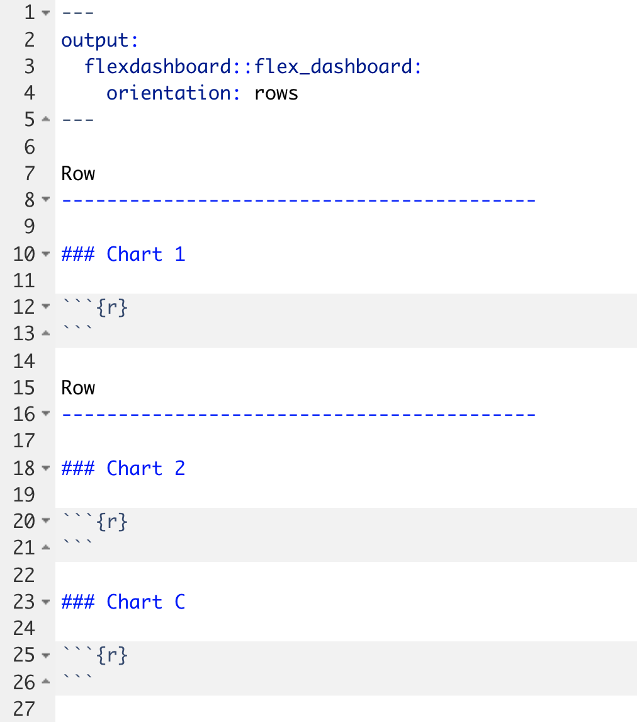
Notes:
If you want to change your chart to be primarily organized as rows, all you have to do is to change the orientation: field in the header to “rows.”
To remind yourself that your dashboard is organized in rows, you should also change the level-2 header to say “Row” although that isn’t strictly necessary.

Slide 8
Your Turn #1
Open 04 – Dashboard.Rmd to work with a draft COVID19 flexdashboard. Do the following:
Knit the document to see what the dashboard looks like.
Change the Test Volumes Over Time plot so that it visualizes the fraction of positive tests on a given day. (Hint: map the fill aesthetic to result). Knit the document again and note the change.
Change the layout from columns to a row orientation. Knit the document again and note the change.
Click “yes” when you are finished!

Slide 9
Making plots interactive
Notes:
A very common feature that you find in many dashboards and make them more user friendly is to make them interactive – by allowing users to hover over specific places to find out more information, and zoom into the data.

Slide 10
Plotly makes ggplots interactive
ggplot(data = data_frame) +
geom_function(mapping = aes(mappings))
my_plot <- ggplot(data = data_frame) +
geom_function(mapping = aes(mappings))
ggplotly(my_plot)
Notes:
Plotly is a package that provides functionality to make ggplots interactive.
Step 1. Start with the ggplot template for making any kind of plot
** Step 2. Capture the ggplot in an object. For example, here I capture the plot as an object named “my_plot”
** Step 3. Write ggplotly(my_plot)
And under the hood, plotly works by generating HTML and JavaScript code that gets embedded into the HTML document that is the dashboard website.

Slide 11
Your Turn #2
Return to 04 – Dashboard.Rmd.
Make the Test Volumes Over Time plot interactive.
Knit the document again to note the change. Hover over the interactive plots. Note what happens when you click on the various buttons that appear above the plot.
Click “yes” when you are finished.
Notes:
// Cover the following:
- I can turn off invalid and negatives to just focus on positives!

Slide 12
Interactive tables
Notes:
Another very common element in dashboards are interactive tables.

Slide 13
DT makes data frames interactive
covid_testing
covid_testing %>%
datatable()
Notes:
We can use the DT package to turn a data frame into an interactive table.
This is even easier than plotly.
**
Step 1. Start with the data frame you’d like to show
Step 2. Pipe it to the function datatable() which is part of the DT package.

Slide 14
Your Turn #3
Return to 04 – Dashboard.Rmd. Let’s try to display a list of positive results in the Details of Positive Test Results area of the plot.
Note that this area currently shows the contents of the covid_testing data frame but doesn’t actually filter for positive results. Add to the pipeline a filter() statement that selects only those rows where the result value is "positive" (Hint: "positive" must be in quotes). Knit the dashboard and note the change.
In order to use the datatable() function, we first need to load the DT package. Add a line to the setup chunk (all the way on top!) to load the DT package.
Now make the table interactive! Knit the dashboard and note the change.
Click “yes” when you are finished!

Slide 15
Add styling

Slide 16
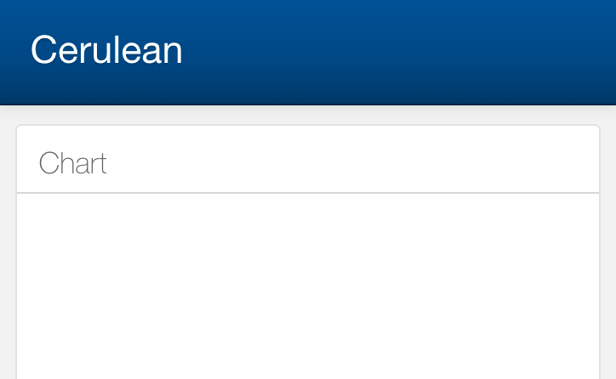
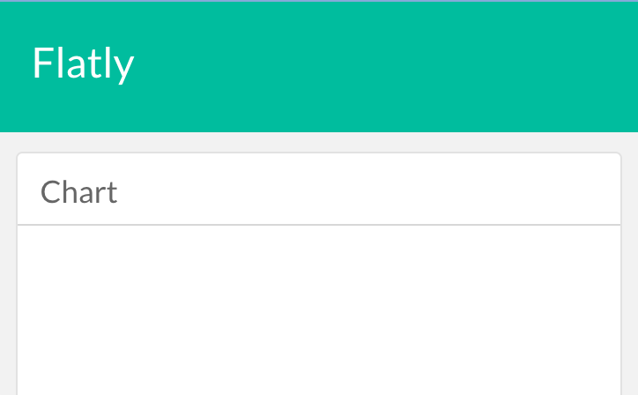
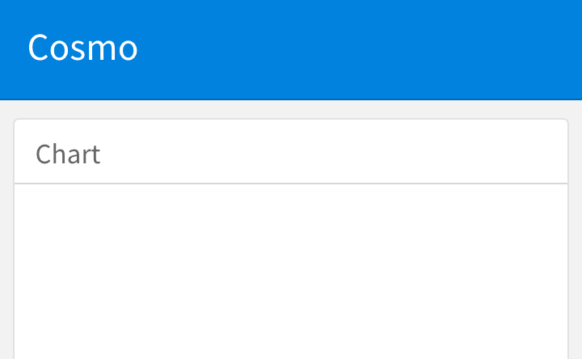
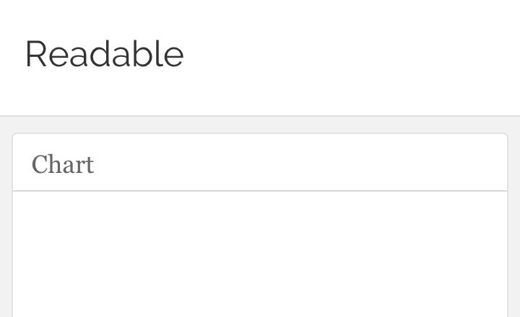
Notes:
There are a few themes that are included with flexdashboard by default.

Slide 17
Adding a theme
---
title: "My Dashboard"
output:
flexdashboard::flex_dashboard:
orientation: rows
theme: cerulean
---
Header
Header
https://rmarkdown.rstudio.com/flexdashboard/using.html#themes
Notes:
Under the hood, themes use a technology called CSS or cascading style sheets. But all of this is hidden away, and all you have to do is add a theme definition in the header of the Rmd document.
This really becomes useful when your organization has created a CSS style sheet that conforms to brand guidelines; can often find those and directly use in flexdashboard. In fact, Joe Mirizio created a CSS file that creates the typeset and colors based on the CHOP style guide.

Slide 18
COVID19 Dashboard Hackathon!
Notes:
In this last exercise of the workshop, we will again send you into breakout rooms. Your TA will share their screen with the COVID19 flexdashboard source code open. The objective is to work as a team to tweak the dashboard using the tools we covered today. In 15 minutes we’ll bring everyone back and take a look at what a 1 or 2 of the groups built!
Just to set expectations - your TA probably isn’t a flexdashboard whiz, and there’s only going to be 15 minutes. But there are a couple of improvements you can make with the tools we’ve covered today, for example change the style, or you might want to add another graph or table, or add a column to the table, or change the color theme of the graph, or tweak the axis labels to make them more descriptive. Have fun!

Slide 19
Recap
Turn R Markdown documents into interactive dashboards with flexdashboard
Turn ggplot objects into interactive plots with plotly
Turn data frames into interactive tables with DT

Slide 20
What else?

Slide 21
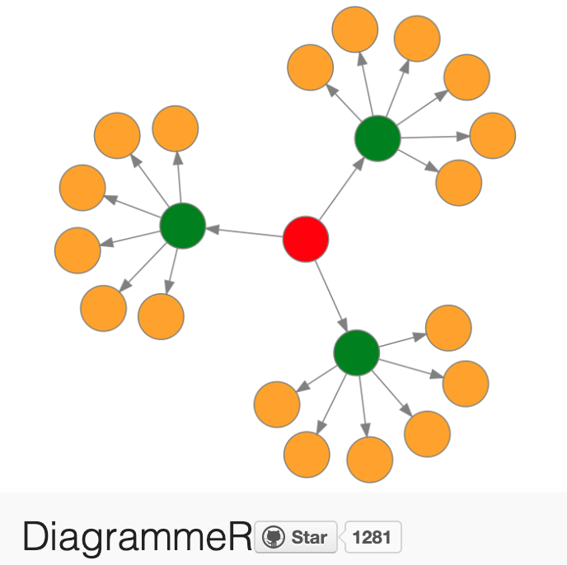
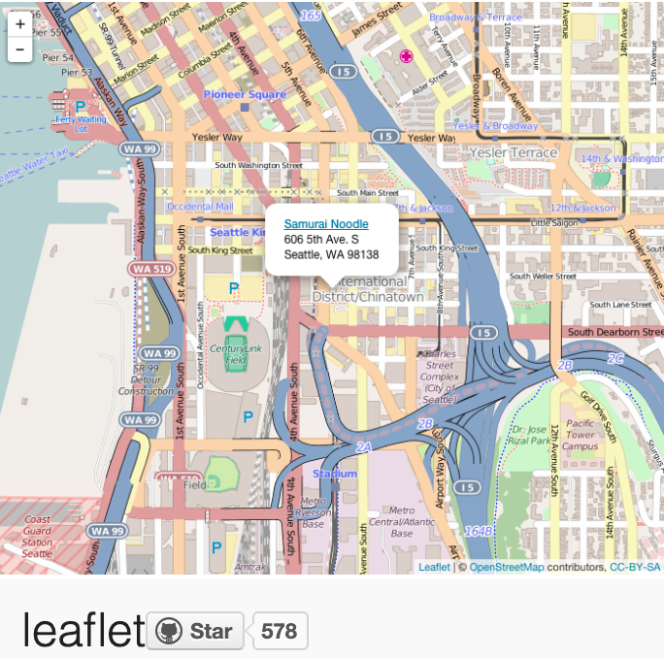
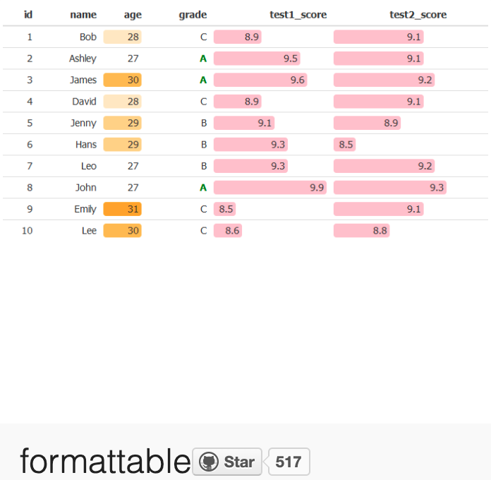
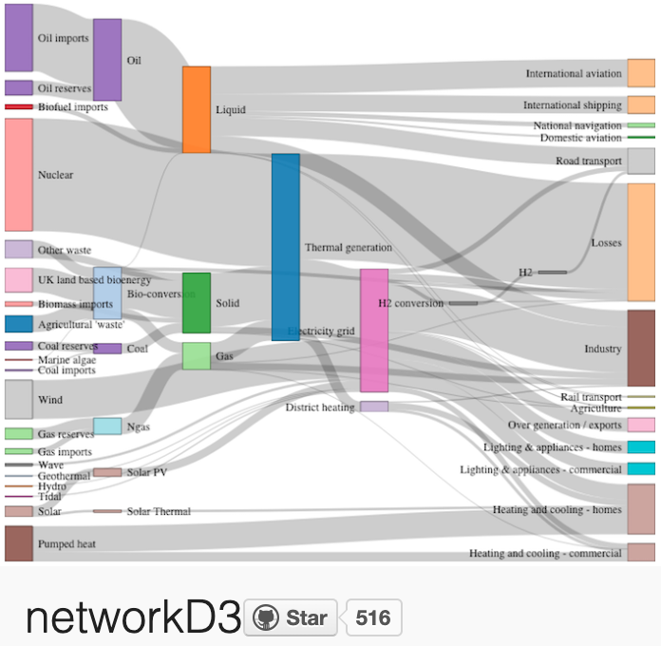
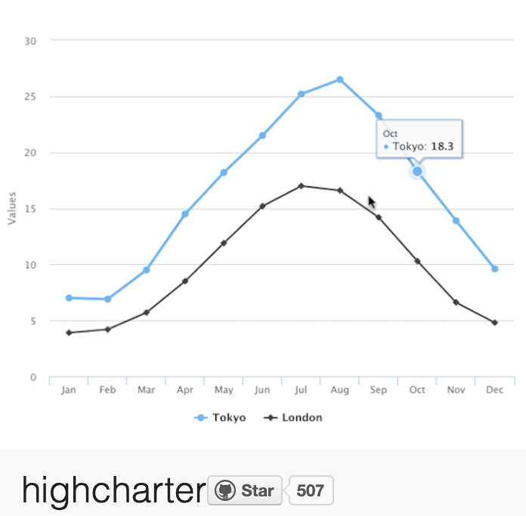
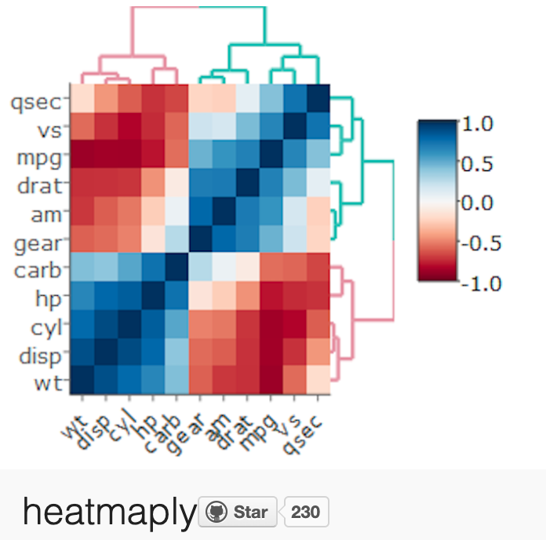
More interactive charts
https://gallery.htmlwidgets.org/
Notes:
In addition to plotly and datatables, there are a large number of additional interactive charts, and a few ones are shown here.

Slide 22
A framework for developing interactive web applications in R
Notes:
Flexdashboards are great if you have a static or regularly updated dataset. If you need your app to interact with a backend database in real time or handle data entry, then you can use Shiny. Shiny is a framework for developing fully featured interactive web applications in R.

Slide 23


Deploying flexdashboards and Shiny apps
Shinyapps.io (free)
Shiny Server (free)
RStudio Connect ($)
Notes:
You can deploy your flexdashboards or Shiny apps either in the cloud or on premise. If you want to deploy a dashboard or app that’s public-facing and doesn’t show any sensitive data, I recommend Shinyapps.io, which is a free service.
For internal-facing apps that may contain sensitive data you can either use Shiny server or Rstudio Connect. At CHOP, our Analytics department manages an RStudio Connect instance, and if you ask them nicely, they’ll allow you to deploy your flexdashboards and Shiny apps there.

Slide 24
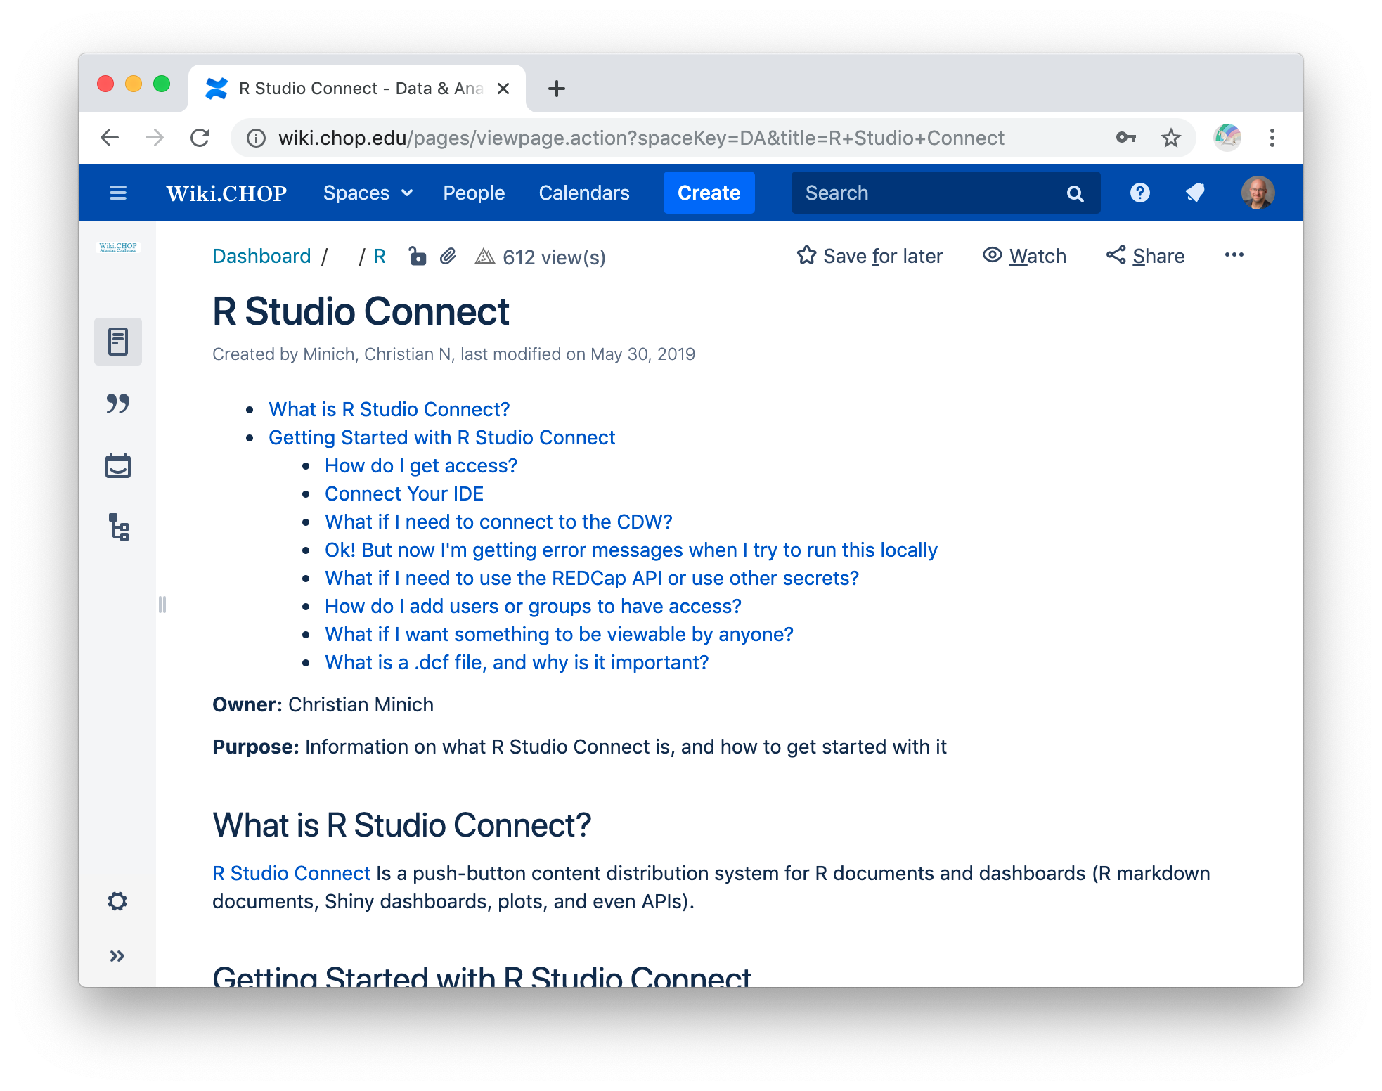
CHOP RStudio Connect
wiki.chop.edu/display/DA/R+Studio+Connect
Notes:
If you’re interested in using RStudio Connect at CHOP, it'll be a good idea to take a look at the RStudio Connect Guide written by Christian Minich, which is available at the address shown above.
Basically, everyone at CHOP has viewing access to the content hosted on our RStudio Connect instance, but you have to email Christian Minich to be allowed to publish your own apps.

Slide 25
What next?
Notes:
So this brings us to the end of the workshop! One of the most frequent questions we get is what can I do to keep learning R after the workshop. We have a few suggestions for that.

Slide 26
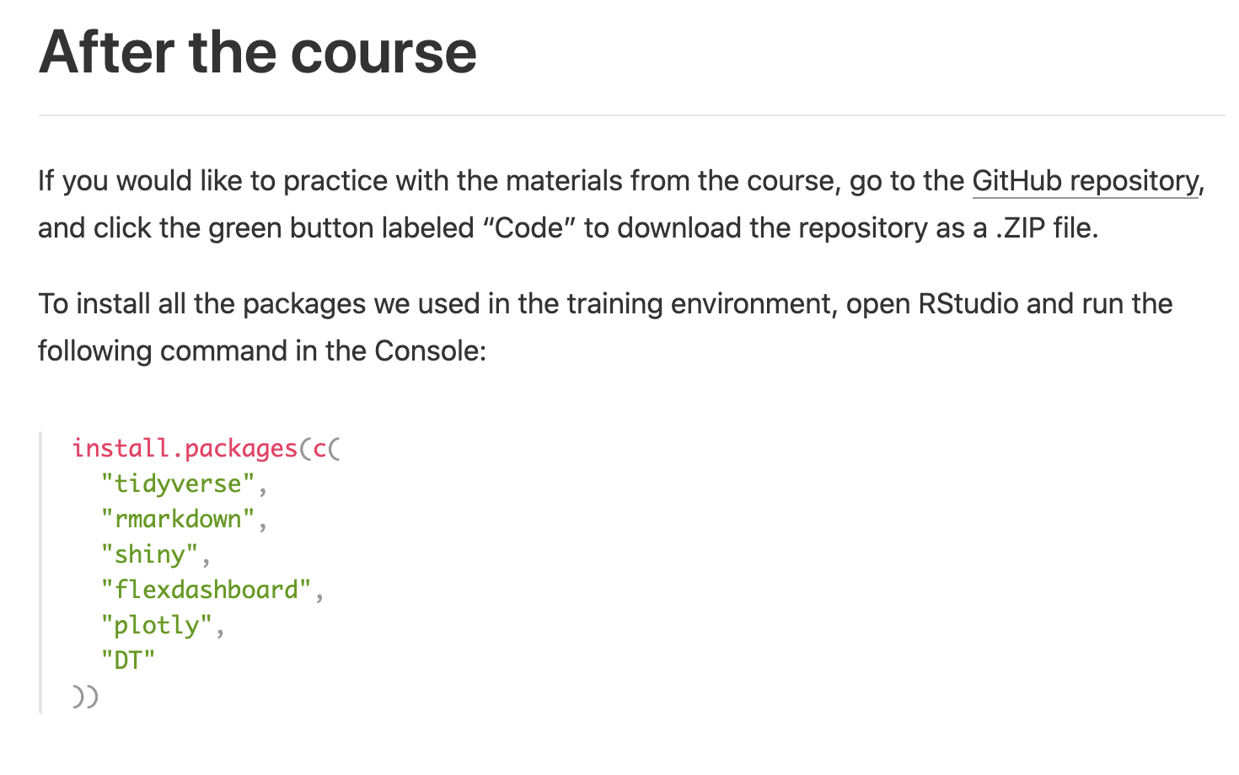

Install R and RStudio on your computer!
https://skadauke.github.io/intro-to-r-for-clinicians-chop/
Notes:
The first thing EVERYBODY should do is to install R and Rstudio on your own computer. ** Check out the video walkthroughs on the course website for help with this.
** Also, if you’d like to practice with the materials of the course on your own computer, the course website has instructions on how you can download them. We will also post a recording of this session on the website within the next 48 (Joy?) hours, so you will always be able to watch it for a refresher.

Slide 27

“Come” to a CHOP R User Group Meeting!
CHOP R User Group Meeting 🗣
Thursday, Dec 10 at 2 PM
Meredith Lee and Cass Wilkinson Saldaña: How to solve small, everyday work problems with R and R Markdown
https://bluejeans.com/849314871
Notes:
The next thing that we recommend is to become part of a community of practice. The best way to do that is to join the CHOP R User group (which is also open to Penn folks). I can’t overstate the importance of having a place to go to ask for help when you start coding. The CHOP R User group has more than 250 members from all departments. This is great place to network with other R users, get help with coding problems, and learn about new packages, webinars, and conferences. We also have semi-regular meetings, and on tomorrow, your TAs Meredith and Cass will be giving a very beginner-friendly talk on solving small, everday work problems with R and R Markdown. You should all have gotten a calendar hold for this - I hope you will all join! Also – Joy, can you drop the link to join the CHOP R User group in the chat?

Slide 28
Do a Mini Project in R!
The only way to learn R is to actually spend some time writing R code.
Identify a work problem that can be solved with a Mini R Markdown document
See tomorrow’s CHOP R User Group meeting for sample Mini projects
Kick-off meeting next week (time TBD)
Get lots of support via CHOP R User Group and Arcus Education
Optional: Give a Mini presentation at an upcoming CHOP R User Group meeting
https://bit.ly/chopr101-miniproject
Notes:
The truest truism in programming is that the only way to learn it is to spend time doing it. It can be difficult to get going in a way that’s doesn’t feel overwhelming, lonely, or even pointless.
To help with this, we came up with the idea of a Mini project in R. The idea is that we’ll help you find a problem in your work that you can solve reproducibly by writing a very small R Markdown document. We purposely set up tomorrow’s CHOP R User Group meeting so that we will showcase some problems that can be solved with Mini R Markdown documents.
If you sign up, we will get you started with a kick-off meeting sometime next week (we’ll send out a Doodle to find a good time), and you will have plenty of support via the CHOP R User Group Slack channel and the Arcus Education team.
If you’d like, we would love for you to give a mini presentation at an upcoming CHOP R User Group meeting about your mini project.
If this sounds interesting to you, please use this link to sign up! And Joy will drop it in the chat as well.

Slide 29
https://r4ds.had.co.nz
https://jrnold.github.io/r4ds-exercise-solutions/
Notes:
Finally, I wanted to point out that “R For Data Science” by Garrett Grolemund and Hadley Wickham is the de-facto standard introduction to data science with R.
This course is designed so that you can pick up this book and keep learning - we use the same packages and conventions as in that book. The entire text is available for free at this address. Each chapter has a lot of exercises,
** and there’s a solutions manual for the exercises online, which makes this great for self-paced learning.

Slide 30

Thank You!!
Richard Hanna
Silvia Canelón
Cass Wilkinson-Saldaña
Rachel Kolster
Jason Xu
Joy Payton
Meredith Lee
Notes:
At this point, I would like to thank all the helpers--
** So to give them a round of virtual applause please click the “yes” button one last time!

Slide 31
Thank You!
Notes:
And a big thank you to all of you CHOP R 101 participants! Hope to see you all tomorrow!

